Slide 1




RecruitX
Path To Success
Minor Project Review-1, B.Tech (CE) Sem-VII
Presented By
Patel Dhruvin Harenkumar (2022095900022652)
Prajapati Alin Kirankumar (2022095900026352)
Patel vishva Miteshbhai (2022095900022443)
Ghiwala Akshat Ranjitkumar (2022095900023616)
Guided By:
Prof. Ekta Patel

Slide 2


Outline
01
Introduction
04
Requirements & Tools
02
Project Overview
05
Design Diagram
03
Functionality & Keywords
06
Conclusion

Slide 3

Introduction
What is a RecruitX Website?
A RecruitX website showcases your skills, projects, and experiences.
Purpose
To create an online presence and demonstrate your abilities to potential employers or clients.
Audience
Potential employers, clients, and collaborators.

Slide 4
Project Overview
Objective
The objective of a RecruitX website is to connect professionals, companies, and recruiters by providing a platform to network, share expertise, and discover career opportunities.
Scope
Features to include: About Me, Projects, Blog, Contact Information.
Goals
User-friendly interface, responsive design, and easy navigation. It is useful to the recruiter to find the best capable and compatible minds over here.

Slide 5
Functionality & Keywords
Targeted Skill Assessment
The HR manager can send specific coding tasks through our app. Out of the 120 students, only those who know Java, say 30 students, will take the test.
Efficient Evaluation
These 30 students complete the coding tasks, and our app automatically checks their performance. The best students are then shortlisted.
Streamlined Interview Process
The top performers are invited for mock interviews, saving the HR manager's time and ensuring only the most skilled candidates are interviewed

Slide 6
Requirements & Tools
Technical Requirements
Domain and hosting
Responsive design
SEO optimization
Tools and Technologies
Frontend: HTML, CSS, JavaScript, React (or another framework).
Backend: Node.js, Express (if needed).
Database: MongoDB, Firebase (if needed).
Design: Figma, Adobe XD.

Slide 7
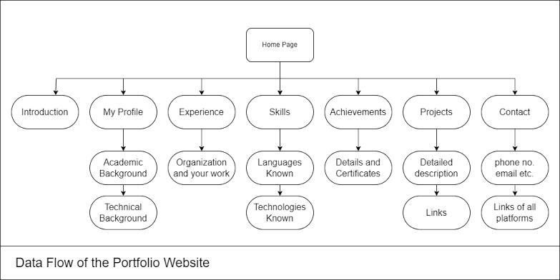
Design Diagram

Slide 8
Conclusion
Summary
Recap of the project's purpose and functionality.
Future Enhancements
Potential improvements and additional features.
Q&A
Open the floor for questions.

Slide 9


Sankalchand Patel College Of Engineering
Thank You

